Slide 1


Mohanaprasath V
11/02/2024

Slide 2

Outline
Executive Summary
Introduction
Methodology
Results
Conclusion
Appendix

Slide 3
Executive Summary
The objective of this project is to determine the price of each launch conducted by SpaceX. This is achieved by
The objective of this project is to determine the price of each launch conducted by SpaceX. This is achieved by gathering information from SpaceX and creating a dashboard for analysis.
The aim of the project is to ascertain whether SpaceX's Falcon 9 will reuse the first stage or not.

Slide 4
Introduction
In this project, our work is to determine what factors influence the price of launches conducted by SpaceX, such as the environment of the launch station and the size of the launcher.
Using different graphs and charts to measure various aspects such as orbit and payload of SpaceX's Falcon 9, we are going to create a machine learning model to determine whether the Falcon 9 will reuse the first stage or not.

Slide 5

Section 1

Slide 6
Methodology
Executive Summary
Data collection methodology:
The data is being collected from the SpaceX REST API.
Perform data wrangling
Use json_normalize() the data is being converted into dataframe and further data wrangling is done.
Perform exploratory data analysis (EDA) using visualization and SQL
Perform interactive visual analytics using Folium and Plotly Dash
Perform predictive analysis using classification models
Build, tune, and assess classification models by selecting algorithms, optimizing parameters, and evaluating performance metrics.

Slide 7
Data Collection
We have collected data from the SpaceX REST API. This API will give us information about the rocket used, payload delivered, launch specifications, landing specifications and landing outcome.
We will use URL starts with api.spacexdata.com/v4/launches/past to target a specific endpoint of the API to get past launch data.
We will perform a get request using the requests library to obtain the launch data, which we will use to get the data from the API.

Slide 8
Data Collection – SpaceX API
The process of Data Collection is explained in the flowchart.
The below given link is the GitHub link of my data collection process.
GITHUB LINK: https://github.com/Mohanaprasath055/Data-Science-final-projects/blob/main/Data%20Collection
start
api.spacexdata.com/v4/launches/past
requests library to obtain the launch data
To convert Json file
to dataframe we use the function Json
normalize function
End

Slide 9
Data Collection - Scraping
Using BeautifulSoup package, we will web scrape some HTML table for analysis.
The below given link is the GitHub link of my data collection process - Scraping.
GITHUB LINK: https://github.com/Mohanaprasath055/Data-Science-final-projects/blob/main/Data%20Collection
start
BeautifulSoup package to web scrape some HTML tables
Parse the data from those tables and convert them into a Pandas dataframe
The dataframe is further used for analysis and visualization
End

Slide 10
Data Wrangling
Some of the attributes: Flight Number, Date, Booster version, Payload mass Orbit, Launch Site, Outcome are the status of the first stage Flights, Grid Fins.
Identify the attributes which has None values in the column and replace it with the mean of the column.
In the final outcome, if the outcome is 1 then it is Good Outcome else Bad Outcome.
GITHUB LINK:
https://github.com/Mohanaprasath055/Data-Science-final-projects/blob/main/Data%20Wrangling

Slide 11
EDA with SQL
The following data has been SQL queries for analysis:
The names of the unique launch sites in the space mission.
First 5 records where launch sites begin with the string 'CCA’.
The total payload mass carried by boosters launched by NASA (CRS).
The average payload mass carried by booster version F9 v1.1
The date when the first successful landing outcome in ground pad was achieved.

Slide 12
The names of the boosters which have success in drone ship and have payload mass greater than 4000 but less than 6000.
The total number of successful and failure mission outcomes.
The names of the booster versions which have carried the maximum payload mass.
The records which will display the month names, failure landing outcomes in drone ship,booster versions, launch site for the months in year 2015.
The rank the count of landing outcomes (such as Failure (drone ship) or Success (ground pad)) between the date 2010-06-04 and 2017-03-20, in descending order.
GITHUB LINK:
https://github.com/Mohanaprasath055/Data-Science-final-projects/blob/main/SQL%20%20queries
12

Slide 13
EDA with Data Visualization
Using scatter plot, analyze Flight number with Launch site, Payload mass with Launch site, Flight number with Orbit.
Using bar chart, the relationship between the success rate of each orbit is been analyzed.
Using line chart, we can analyze the success rate of each orbit by year.
GITHUB LINK:
https://github.com/Mohanaprasath055/Data-Science-final-projects/blob/main/Data%20visualization

Slide 14
Build an Interactive Map with Folium
In this project, I have used folium circle, MarkerCluster(), add_child(), DivIcon
Folium circle is used to circle the area in the map which represent specific coordinates which contains the NASA JSC’s location.
MarkerCluster() is used to narrow down the locations and identify specific locations. Since the presence of large data may affect our accuracy, we use MarkerCluster() with the NASA location to narrow it down.
add_child() is used add plugins. In our project we have used add_child() to add circle, marker as a child to a specific columns in each case.
DivIcon() is used to create map content using HTML and CSS. In our case, DivIcon() is used to design the map.
GITHUB LINK: https://github.com/Mohanaprasath055/Data-Science-final-projects/blob/main/Data%20visualization

Slide 15
Predictive Analysis (Classification)
In the predictive analysis, we imported and check the various machine algorithm such as logistic regression, support vector machine, Decision Tree and we have concluded which algorithm is best for our model.
We transform() in order to standardize the data
The train_test_split() is used to split our entire dataset in two parts, The first part is for train the model and the second part is for test our data. For which our test data size is 0.2 and random state as 2 to ensure no same type of data is used for training.

Slide 16
After completing the splitting, we use the GridSearchCV() to identify the best hyperparameters for a machine learning model and fit() to fit the data into the model.
For every machine learning algorithm, we use the score() to identify the accuracy of the dataset.
Finally, we use the predict() to display the confusion matrix which helps us to determine the correct model for a data.
After calculating all the accuracy of machine learning we can conclude that logistic regression is best used for our model.
16

Slide 17
Results
Exploratory data analysis results
Interactive analytics demo in screenshots
Predictive analysis results

Slide 18

Section 2

Slide 19
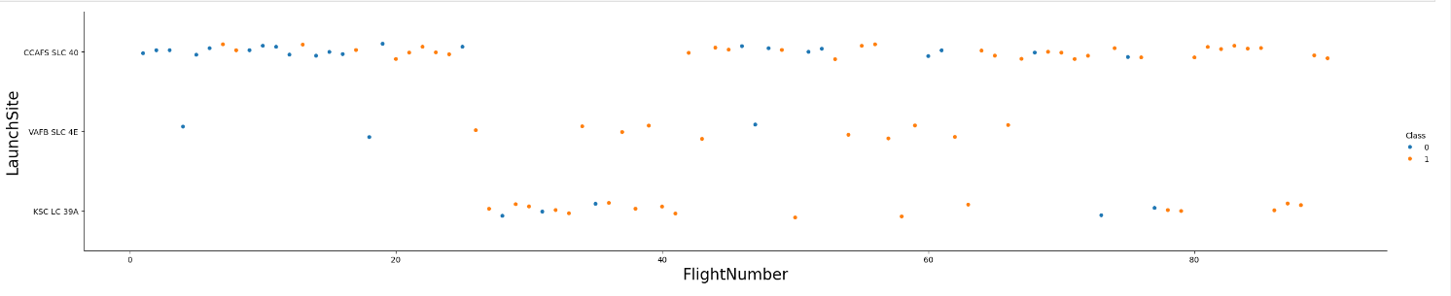
Flight Number vs. Launch Site
H
Where 0 represent False and 1 represent True

Slide 20
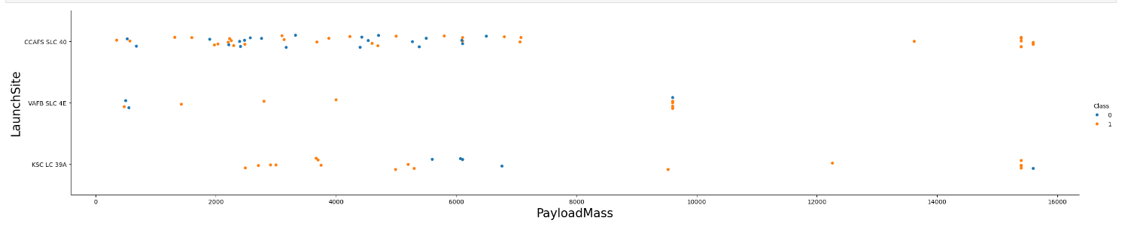
Payload vs. Launch Site
A

Slide 21
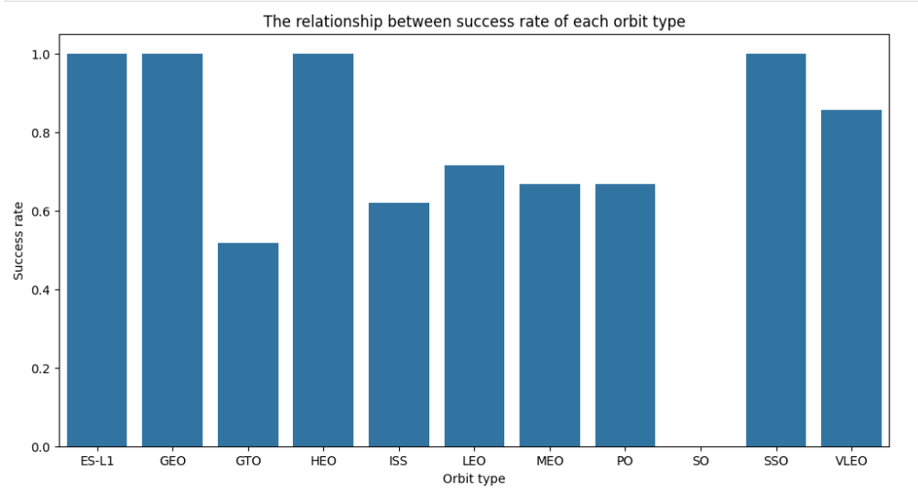
Success Rate vs. Orbit Type
a

Slide 22
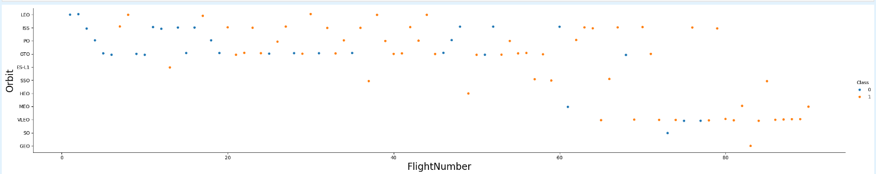
Flight Number vs. Orbit Type
Show a scatter point of

Slide 23
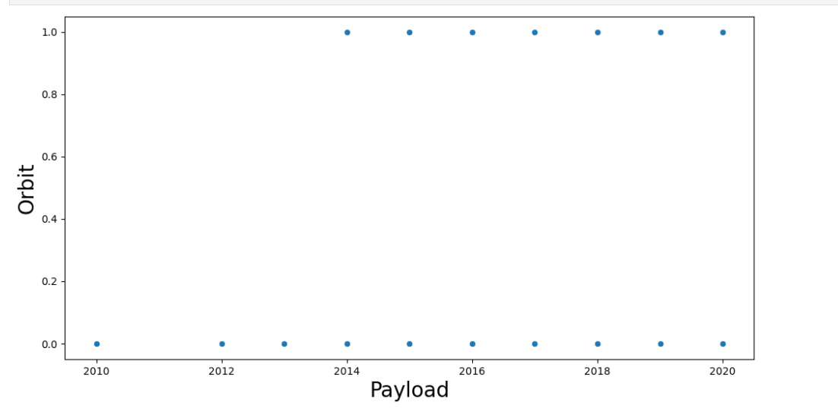
Payload vs. Orbit Type
h

Slide 24
Launch Success Yearly Trend
Show a line chart of yearly

Slide 25
All Launch Site Names
Find the names of the unique launch sites
Present your query result with a short explanation here

Slide 26
Launch Site Names Begin with 'CCA'
Find 5 records where launch sites begin with `CCA`
Present your query result with a short explanation here

Slide 27
Total Payload Mass
Calculate the total payload carried by boosters from NASA
Present your query result with a short explanation here

Slide 28
Average Payload Mass by F9 v1.1
Calculate the average payload mass carried by booster version F9 v1.1
Present your query result with a short explanation here

Slide 29
First Successful Ground Landing Date
Find the dates of the first successful landing outcome on ground pad
Present your query result with a short explanation here

Slide 30
Successful Drone Ship Landing with Payload between 4000 and 6000
List the names of boosters which have successfully landed on drone ship and had payload mass greater than 4000 but less than 6000
Present your query result with a short explanation here

Slide 31
Total Number of Successful and Failure Mission Outcomes
Calculate the total number of successful and failure mission outcomes
Present your query result with a short explanation here

Slide 32
Boosters Carried Maximum Payload
List the names of the booster which have carried the maximum payload mass
Present your query result with a short explanation here

Slide 33
2015 Launch Records
List the failed landing_outcomes in drone ship, their booster versions, and launch site names for in year 2015
Present your query result with a short explanation here

Slide 34
Rank Landing Outcomes Between 2010-06-04 and 2017-03-20
Rank the count of landing outcomes (such as Failure (drone ship) or Success (ground pad)) between the date 2010-06-04 and 2017-03-20, in descending order
Present your query result with a short explanation here

Slide 35

Section 3

Slide 36
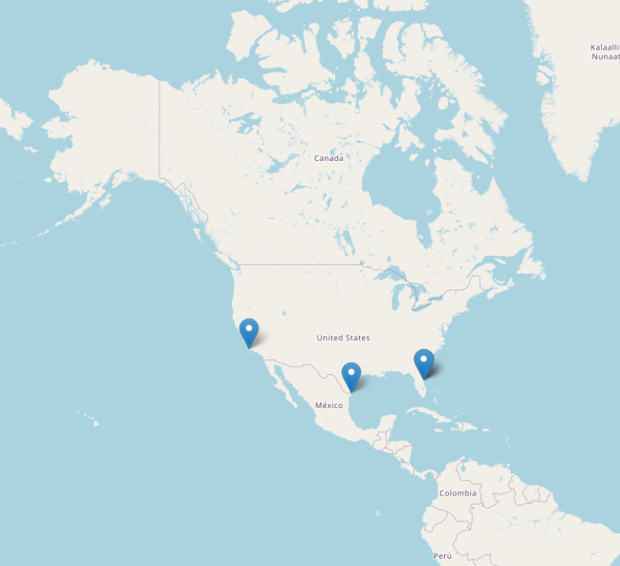
All Launch site on a map
There are 3 main location of falcon 9 launcher.

Slide 37
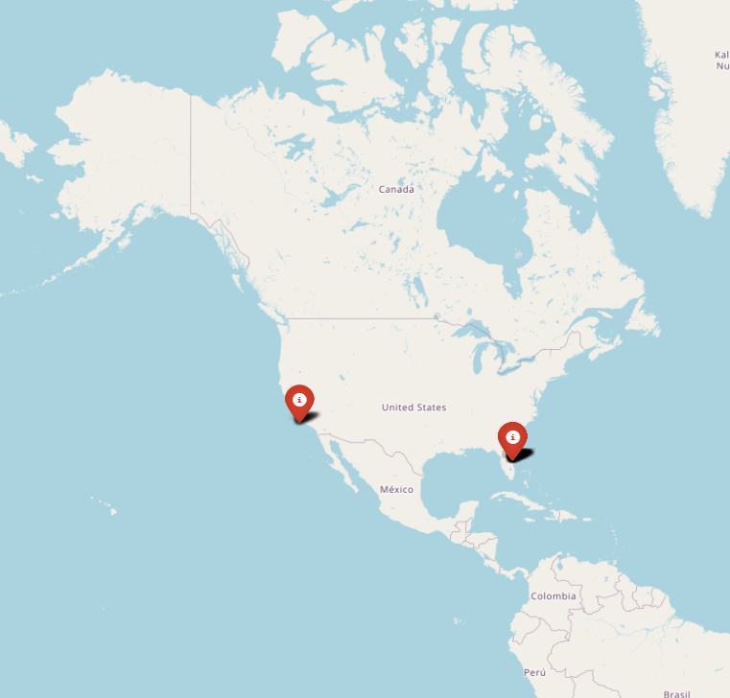
The success/failed launches for each site on the map

Slide 38
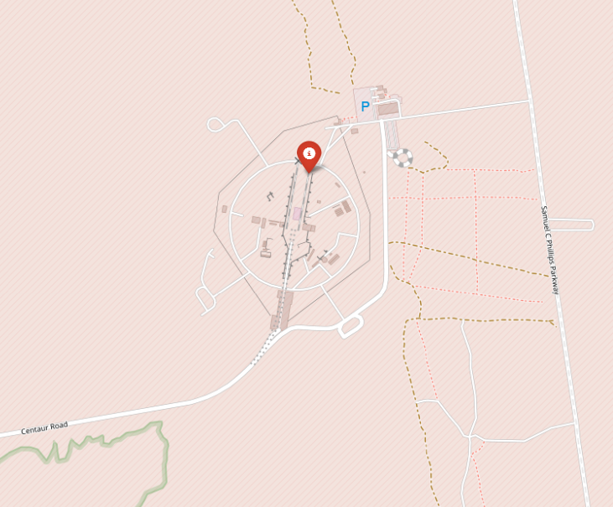
<Folium Map Screenshot 3>

Slide 39

Section 4

Slide 40
<Dashboard Screenshot 1>
Replace <Dashboard screenshot 1> title with an appropriate title
Show the screenshot of launch success count for all sites, in a piechart
Explain the important elements and findings on the screenshot

Slide 41
<Dashboard Screenshot 2>
Replace <Dashboard screenshot 2> title with an appropriate title
Show the screenshot of the piechart for the launch site with highest launch success ratio
Explain the important elements and findings on the screenshot

Slide 42
<Dashboard Screenshot 3>
Replace <Dashboard screenshot 3> title with an appropriate title
Show screenshots of Payload vs. Launch Outcome scatter plot for all sites, with different payload selected in the range slider
Explain the important elements and findings on the screenshot, such as which payload range or booster version have the largest success rate, etc.

Slide 43

Section 5

Slide 44
Classification Accuracy
Visualize the built model accuracy for all built classification models, in a bar chart
Find which model has the highest classification accuracy

Slide 45
Confusion Matrix
Show the confusion matrix of the best performing model with an explanation

Slide 46
Conclusions
Point 1
Point 2
Point 3
Point 4
…

Slide 47
Appendix
Include any relevant assets like Python code snippets, SQL queries, charts, Notebook outputs, or data sets that you may have created during this project

Slide 48


